Slide 1


Django Workshop 2022
Day 3
Rishabh Rathi

Slide 2
Today's Agenda
Django Template Language
Django Models
Database Handling
Redirect view
Complete URL Shortening view
Create basic analytics

Slide 3
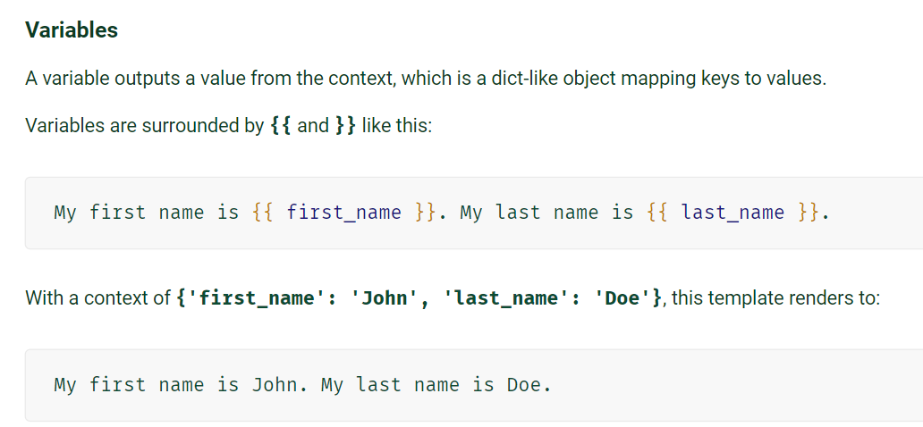
Template Language

Slide 4
Template Language
For Loop
  {% for i in list %}
  // statements
  {% endfor %}
If else
  {% if variable %}
  // statements
  {% else %}
  // statements
  {% endif %}

Slide 5
Small Task
Step 1 : Create a new html page named “task.html”
Step 2 : We need a new url localhost:8000/task.
Step 3 : We need a view which will respond with task.html
Step 4 : We need dynamic data on our html page

Slide 6
DATABASE HANDLING
We are working with Relational Database.
A database consists of several tables.
In simple terms, a database table can be thought of as consisting of rows and columns.
Language used to interact with relational db - Structured Query Language (SQL).

Slide 7
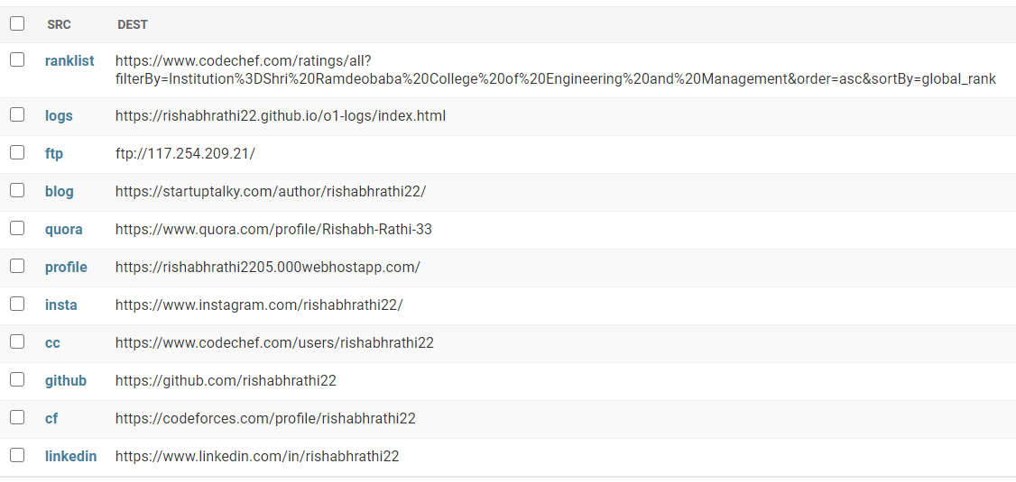
Sample Database

Slide 8
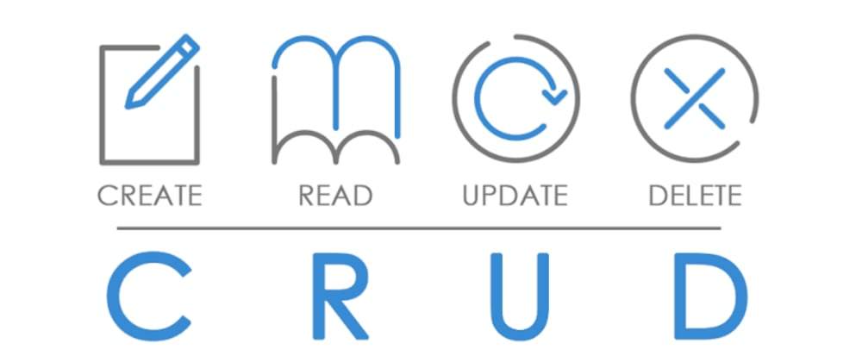
Operations on Database

Slide 9
Don't know SQL? - Django ORM
ORM is an acronym for the Object-Relational mapper.
The ORM automates transmission of data between database and application, such that the developer need not write any SQL.
Django is shipped with its own ORM (very efficient).
Querysets are Django’s way to retrieve data from the database.
A Queryset is a list of objects of a model. We use Querysets to filter and arrange our data.

Slide 10
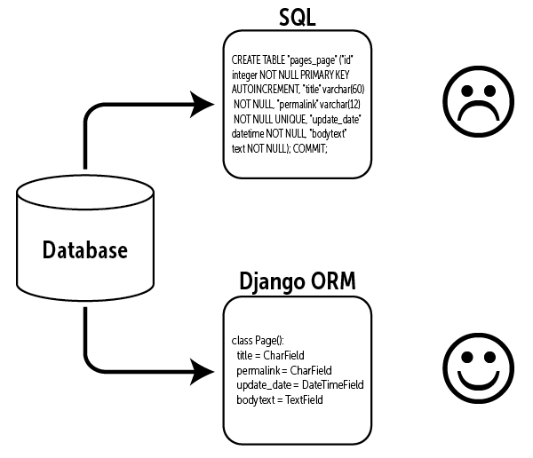

Slide 11
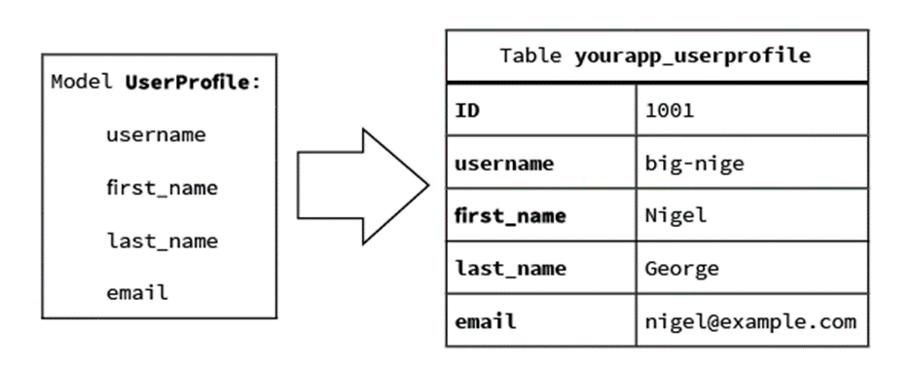
Django Models
A Django model is the built-in feature that Django uses to create tables, their fields, and various constraints. In short, Django Models is the SQL of Database one uses with Django.
SQL (Structured Query Language) is complex and involves a lot of different queries for creating, deleting, updating or any other stuff related to database. Django models simplify the tasks and organize tables into models. Generally, each model maps to a single database table.

Slide 12
How to create Models?
Step 1 : Add class in models.py
class LongToShort (models.Model):
longurl = models.URLField(max_length=250)
shorturl = models.CharField(max_length=25, unique=True)
date = models.DateField(auto_now_add = True)
visit_count = models.IntegerField(default = 0)
Step 2 : Register our model to admin site (admin.py)
admin.site.register(LongToShort)

Slide 13
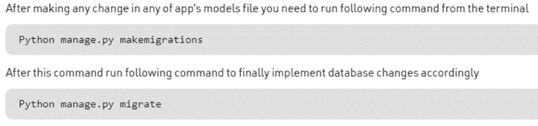
MUST-DO Steps

Slide 14
Django Admin
One of the most powerful parts of Django is the automatic admin interface.
It reads metadata from your models to provide a quick, model-centric interface where trusted users can manage content on your site.

Slide 15
Creating Objects (Adding Rows)
To create an object, instantiate it using keyword arguments to the model class, then call save() to save it to the database.
>>> obj = LongToShort (
longurl = 'https://drive.google.com/file/d/1RsuU24ud',
shorturl = 'day2video')
>>> obj.save( )
This performs an INSERT SQL statement behind the scenes.

Slide 16
Read Rows
Retrieving all objects - use the all( ) method
>>> all_entries = LongToShort.objects.all()
Retrieving specific objects with filters - use the filter( ) method
>> some_entries = LongToShort.objects.filter(shorturl = 'myprofile')
Retrieving a single object with get( )
>> one_entry = LongToShort.objects.get(shorturl = 'myprofile')
* If you know there is only one row that matches your query, you can use the get() method.
If there is no row or there is more than 1 row matching the condition - It will give error.

Slide 17
Update Rows (objects)
To save changes to an object that’s already in the database, use save().
Given a LongToShort instance obj that has already been saved to the database, this example changes its visit count and updates its record in the database:
>>> obj.visits = obj.visits + 1
>>> obj.save( )

Slide 18
Delete Rows (objects)
The delete method, conveniently, is named delete().
This method immediately deletes the object and returns the number of objects deleted.
Example: This code deletes all links with longurl 'http://google.com'.
>>> LongToShort.objects.filter(longurl = 'http://google.com').delete()

Slide 19

View - Shorten
Input long url (https://drive.google.com/file/d/1RsuU24ud2GxVwTeQR_2VCY0bzYidBdEu)
home_page view
Input shorturl (mysite)
USER
Store
in db
longurl | shorturl | date | visit_count
https://drive.google.com/file/d/1RsuU24ud2GxVwTeQR_2VCY0bzYidBdEu | mysite | 03/04/2022 | 0
Return data to user

Slide 20
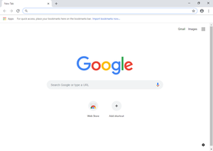
View - Redirect
Visit short url
Search shorturl in db
redirect_url view
http://localhost:8000/mysite
USER
>>> obj = LongToShort.objects.get(shorturl = “mysite”)
>>> matching_longurl = obj.longurl
Redirect user to long url

Slide 21
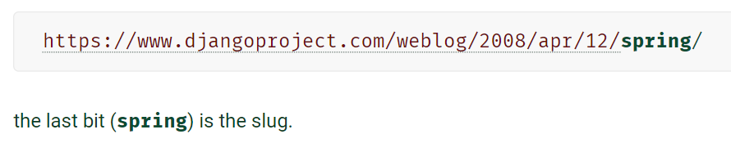
Slug in Django
Slug is a newspaper term.
A slug is a short label for something, containing only letters, numbers, underscores or hyphens.
They’re generally used in URLs.

